Slide 1

MetaTensor
Bittensor Governance & Efficiency Optimizer Subnet
• AI-Powered
• Incentive-Aligned
• Self-Optimizing Network

Slide 2
The Problem
128+ Bittensor subnets, but no unified governance intelligence
TAO emissions are not optimally aligned with subnet value
No early warning system for failing or malicious subnets
Governance actors work with fragmented, manual metrics
Ethereum-style governance is slow, manual, and reactive

Slide 3
The Solution – MetaTensor
✓ First subnet that analyzes Bittensor itself
✓ Continuous network health scores & risk rankings
✓ AI-powered TAO emission optimization recommendations
✓ Collusion & centralization detection alerts
✓ Comparative efficiency metrics vs Ethereum and others

Slide 4
Mechanism: Miners, Validators, Rewards
Miners
Validators
Ingest Bittensor + external chain data
Predict subnet risk, emission efficiency, anomalies
Propose new emission weights & governance signals
Ingest Bittensor + external chain data
Predict subnet risk, emission efficiency, anomalies
Propose new emission weights & governance signals
Rewards
Miners: 75% of subnet emission via softmax on performance
Validators: 25% for honest, diverse evaluation

Slide 5
Proof of Intelligence / Effort
★ Miners must model time series, stake graphs, game theory
★ Backtesting over 30–90 days – can't fake long‑term accuracy
★ Sentinel tasks detect trivial heuristics and copy‑paste agents
★ Tasks include risk prediction, emission optimization, anomaly detection
★ Only miners with genuine predictive power earn meaningful TAO

Slide 6
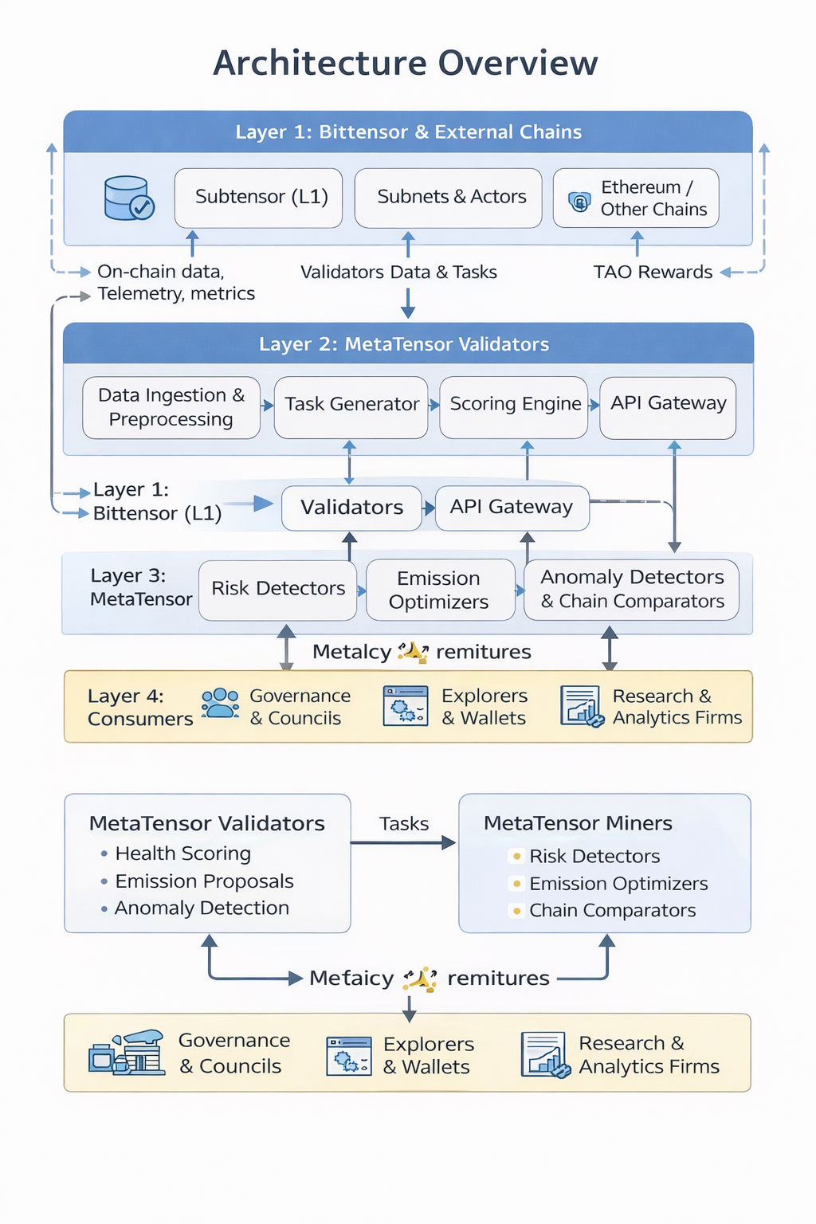
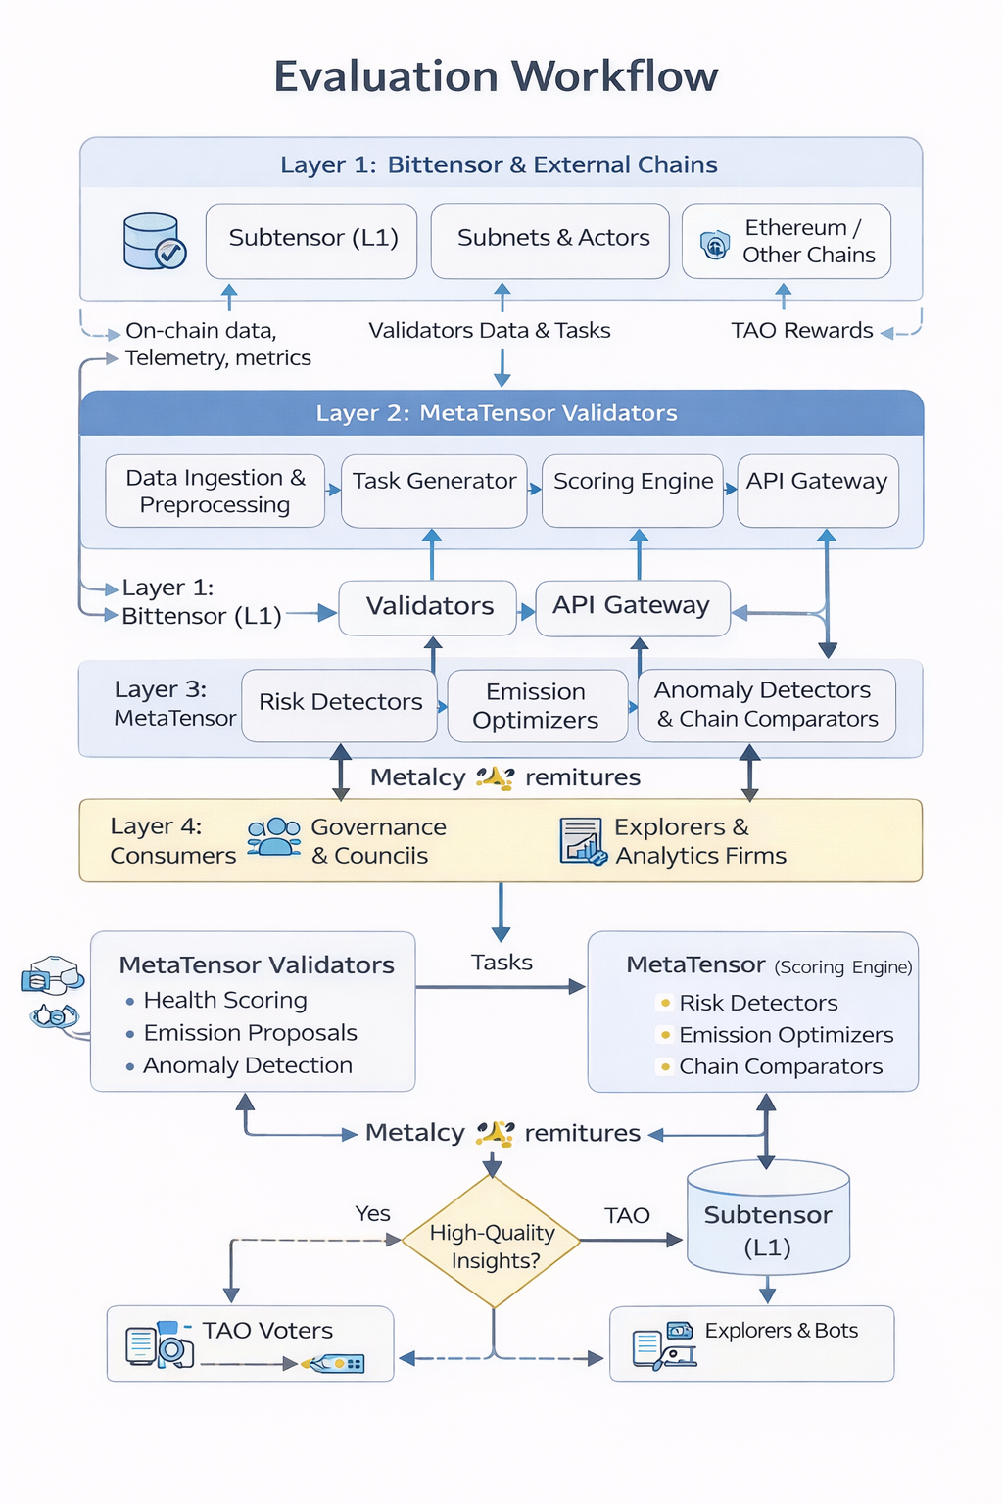
Architecture Overview
Evaluation Workflow

Slide 7
Market & Users
Sector: Infra (governance & network optimization)
Primary customer: Bittensor protocol itself
Key users:
→Governance councils & TAO voters
→Explorers / dashboards (Taostats‑like)
→Stakers & delegators (risk‑aware staking tools)
No existing governance subnet – pure first‑mover advantage

Slide 8
Why MetaTensor Wins
♦ Unclaimed niche: no other subnet optimizes Bittensor governance
♦ Highest leverage: optimizes the whole network, not one vertical
♦ Network effects: more subnets → more value from MetaTensor
♦ Makes Bittensor more adaptive than Ethereum in governance
♦ Strong story for Bitstarter / discretionary investment

Slide 9
Go-To-Market Strategy
Phase 1 (Hackathon):
• Testnet subnet with basic health & anomaly tasks
• Public API + simple web dashboard
Phase 2 (Mainnet):
• Integration with explorers, wallets, governance tools
• "MetaTensor score" shown for every subnet & address
Bootstrapping:
• Higher miner share initially
• Early validator bonuses
• Free API tier for ecosystem projects

Slide 10
Vision & Roadmap
Now – Feb 28: Ideathon – design + proposal + repo (this deck + site)
Mar 2 – Mar 30: Hackathon – testnet implementation of core tasks
Q2 2026: Mainnet launch, explorer integration, governance trial
Q3+ 2026: Become default governance signal layer for Bittensor

